Slide 1
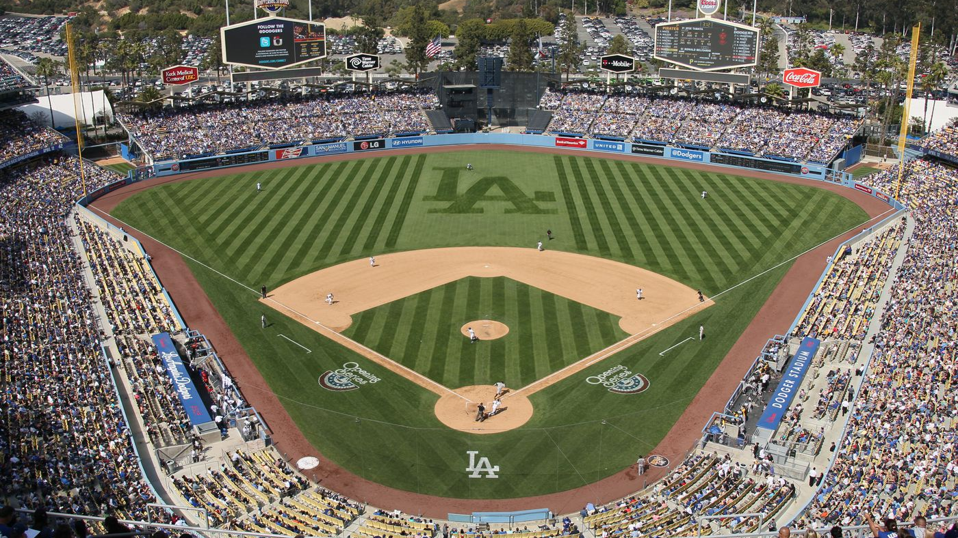
Finding the Best Statistic that Leads to Wins in Baseball
Richard Kang
University of Colorado Boulder

Slide 2
Executive Summary
Baseball – MLB – One of the most popular sports in the country and the world
Project will aim to compare certain relevant statistics with wins
Linear Regression and Correlation analysis will be used
Data will come from Sean Lahman’s website – He is a reporter

Slide 3
Executive Summary
Effectiveness will be found by comparing training model to testing data
Efficiency will be found by calculating run time of each iteration of each process
Key findings include ERA having a stronger effect on wins than HR
RA – Strongest effect, SB – Weakest effect

Slide 4
Problem Statement
Which statistic(s) should a baseball organization value the most in order to maximize wins, revenue and fan retention?
E.g., Should a batter with higher runs batted in (RBI) be valued more than a player with more home runs (HR)?
E.g., Should a pitcher be looked at more favorably if they have a lower earned run average (ERA) or a higher outs pitched (IPouts)?

Slide 5
Related Work – Completed Work #1
Freker, a student, used correlation analysis to compare statistics with team wins
Correlation coefficient ranging from -1 to 1
Ks per Walk and Winning Percentage – High Correlation
Home Runs and Winning Percentage – Moderate Correlation

Slide 6
Related Work – Completed Work #2
Wolf, from Samford University, found the correlation coefficient and linear regression line for multiple statistics compared to winning percentage
r = 0.716 for batting average and winning percentage
Equation of Linear Regression line – y = 5.055x - 0.7669
Slope = 5.055 – increase batting average by 1%, increase winning percentage by 5.055% on average
Found batting and pitching statistics to affect wins the most; fielding the least

Slide 7
Proposed Work – Dataset
Dataset from Sean Lahman’s website (reporter)
.csv, .R, SQL file
Relevant statistics for batting, pitching, and fielding
G, W, SB, ERA, FP are some examples of this

Slide 8
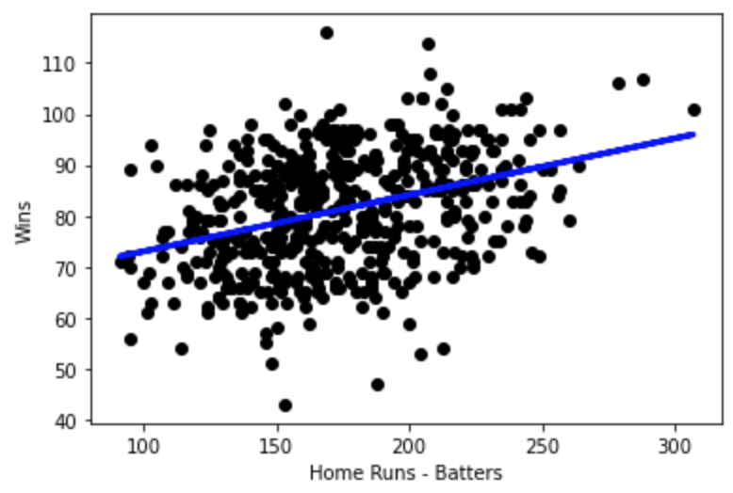
Proposed Work – Statistical Analysis & Visualization
Scatter plot of Home Runs vs. Wins
Linear Regression Line – Coefficient of 0.10777187
Outliers present – Seasons where team excel at hitting home runs, however, play poorly in other areas such as pitching

Slide 9
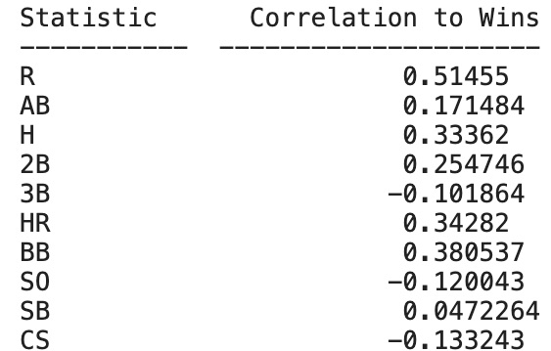
Proposed Work – Statistical Analysis & Visualization
First few statistics from Table of Statistic vs. Correlation to Wins
Values from -1 to 1 (Correlation Coefficient)
R has Correlation Coefficient of 0.51455, Moderate Correlation

Slide 10
Proposed Work – Data Preprocessing
Filter for data points with 162 games to standardize and make analyzing fair and reasonable
Split data into training and testing sets (80/20 split)
Remove NA values – not useful for analysis
Dummy variables
Average/Mean of column

Slide 11
Proposed Work – Specific Questions
HR has a correlation coefficient to wins of 0.34282
ERA has a correlation coefficient to wins of -0.649373
ERA affects wins more than HR
Highest effect – RA – -0.651188
Lowest effect – SB – 0.0472264
Patterns within specific components of game (e.g., batting) for the most part, however, not to a strong extent

Slide 12
Evaluation
Effectiveness – Use model created with training set to compare with testing data
Efficiency – Look at run times for each method
Compare which method is more effective and/or efficient

Slide 13
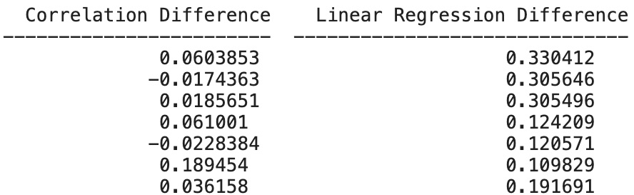
Evaluation
Linear Regression - Used training model to predict actual testing data
Took mean of each variable, then calculated the difference between predicted and actual values
Correlation – Found difference between training correlations and testing correlations

Slide 14
Evaluation
Correlation – Mean difference of 0.006819480504763156
Linear Regression – Mean difference of 0.0999535555398691
Both effective, Correlation more effective than Linear Regression
Efficiency – Run times very small – Basically a tie
Prefer to use Correlation analysis due to it being more effective and easier to compare variables – Values can only be between -1 and 1

Slide 15
Future Work
Another dataset could be used to verify results
Additional questions to ask – Do advanced metrics like DER (Defensive Efficiency Ratio) affect wins more than the metrics used in this project?
Does weather play a part in win totals?
Machine Learning methods could be used – Clustering, Anomaly Detection, etc.
Larger scale project would be useful, if possible

Slide 16
Timeline
Week 2 – Project Proposal - Done
Week 3 – Project Checkpoint - Done
Week 4 – Project Final Report - Done
Week 5 – Project Presentation - Current

